Slide 1
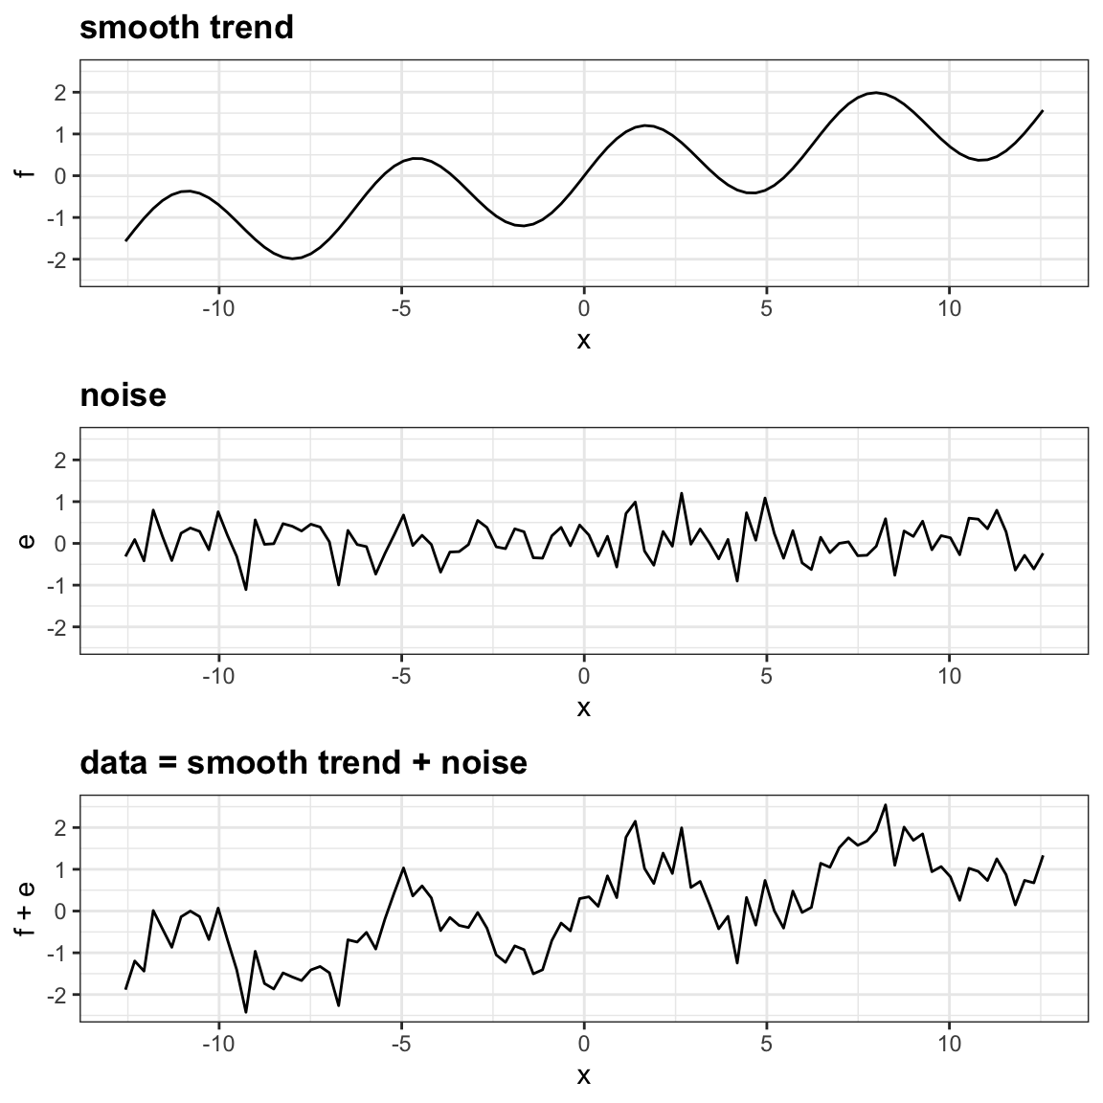
SMOOTHING
Review: what is noise?
data = signal + noise
Ex, model data:
signal = what a perfect model would predict
noise = unpredictable part of model’s forecast (initial errors compound – think butterfly effect)
Why do we smooth data?
To reduce noise (high frequency variability) in data so signals (trends, patterns) are more discernible
Note: smoothing can also be described as a “filtering” process
Plot courtesy of Rafael A. Irizarry, from “Introduction to Data Science: Data Analysis and Prediction Algorithms with R”, https://rafalab.github.io/dsbook/smoothing.html.This work is licensed under the Creative Commons Attribution-NonCommercial-ShareAlike 4.0 International CC BY-NC-SA 4.0.
“,

Slide 2
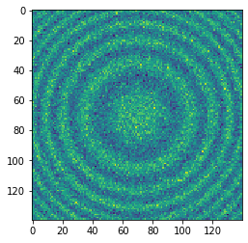
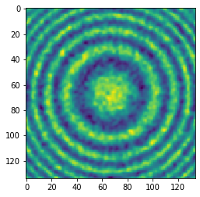
SMOOTHING
Unsmoothed
Review: what is noise?
data = signal + noise
Ex, model data:
signal = what a perfect model would predict
noise = unpredictable part of model’s forecast (initial errors compound – think butterfly effect)
Why do we smooth data?
To reduce noise (high frequency variability) in data so signals (trends, patterns) are more discernible
Note: smoothing can also be described as a “filtering” process
Smoothed

Slide 3
COMMONLY USED SMOOTHING TECHNIQUES
Commonly used techniques include:
Moving window average
Savgol filter
Curve-fitting (necessitates knowing functional form)
Moving window average: replaces each original data point with the average of data within a defined window around it
User chooses the type of the window: determines the weights given to data points within the window
Ex: Boxcar, Gaussian, Triangular
User chooses the width of the window
Consider: what is the time-scale of the signal you are wanting to study?
Else, experiment!

Slide 4
COMMONLY USED SMOOTHING TECHNIQUES
Savgoy Filter: fits a polynomial in a defined window of data points surrounding each point through least-squares
May preserve original shape and feature of the signal more than moving average
User chooses the order of the polynomial
User chooses the width of the window
Plot courtesy of Rafael A. Irizarry, from “Introduction to Data Science: Data Analysis and Prediction Algorithms with R”, https://rafalab.github.io/dsbook/smoothing.html.This work is licensed under the Creative Commons Attribution-NonCommercial-ShareAlike 4.0 International CC BY-NC-SA 4.0.
“,

